Slide 1
Heuristic Search
If we can order our search choices in some meaningful way so that more promising paths are searched first then efficiency is much improved
Heuristic is an estimated cost or weighting that we use to judge a path
Generally it is the estimated cost from our current node to the Goal node e.g.
  Geographical Path
    Straight line distance from here to destination (Euclidean distance)
    Number of tiles away (Manhattan distance)
  Draughts, Chess, etc. ?
    Strength of current position

Slide 2
Heuristic Search
Space is represented as graph of nodes
Each edge is directed
Each edge has an associated weight or cost
  cost > 0
  Represents distance (usually)
    can represent different terrains etc.
Given that we know the cost of each step, find path from A to B with lowest overall cost

Slide 3
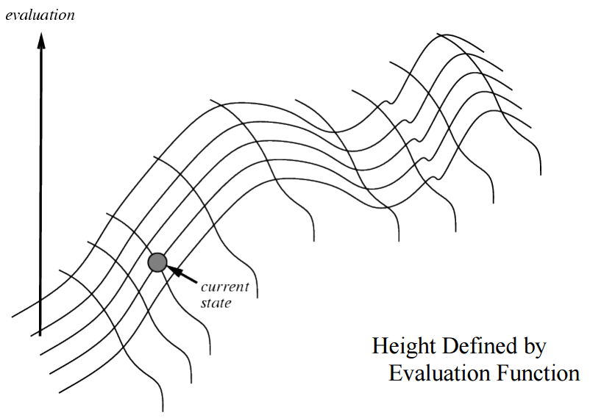
Hill Climbing Search
With this in mind we can turn
Depth First Search into
Hill Climbing
  By changing one line in the algorithm!
When inserting new nodes in queue first sort them by estimated distance from the goal node
Then add new paths to queue!

Slide 4
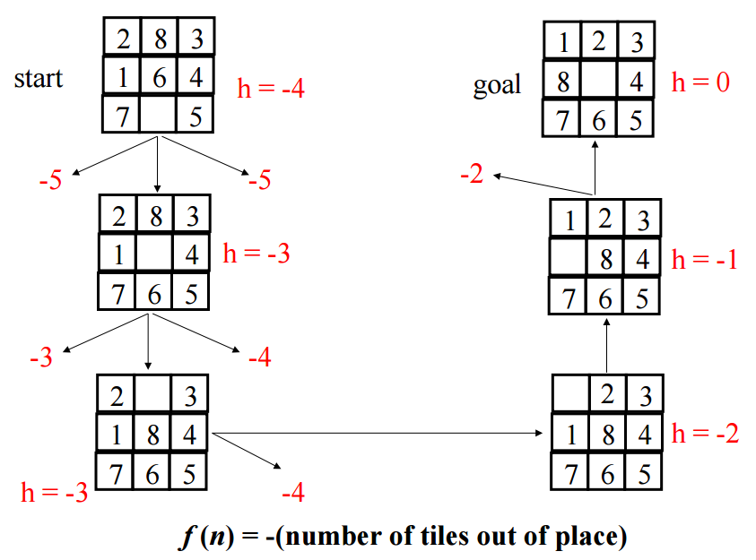
Hill Climbing
We always choose the next step that climbs up the gradient
When we cannot go up any more we are at summit
Example:

Slide 5
Hill Climbing
We always choose the next step that climbs up the gradient
When we cannot go up any more we are at summit
Example:

Slide 6
Hill Climbing
We always choose the next step that climbs up the gradient
When we cannot go up any more we are at summit
Example:

Slide 7
Hill Climbing
We always choose the next step that climbs up the gradient
When we cannot go up any more we are at summit
Example:

Slide 8
Hill Climbing
We always choose the next step that climbs up the gradient
When we cannot go up any more we are at summit
Example:

Slide 9
Hill Climbing
We always choose the next step that climbs up the gradient
When we cannot go up any more we are at summit
Example:

Slide 10
Hill Climbing
Very low memory usage
  Only needs current node and its neighbours
  Everything else is forgotten
What could go wrong?
  No, really that’s a question

Slide 11
Hill Climbing Problems
Plateau Problem
  When we are on a plateau how do we choose the next step? (can lead to blind search!)
Foothill Problem
  The peak we have found is not the summit but only the top of a neighbouring foothill
  That is, it is a local maximum, not the global one!

Slide 12
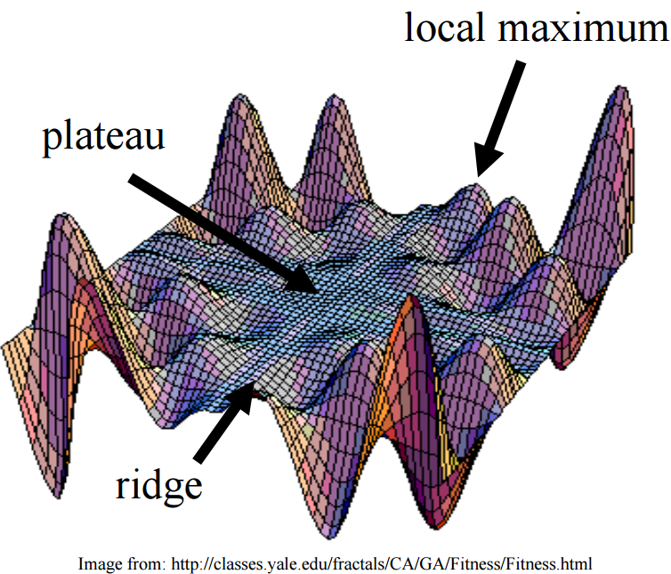
Hill Climbing Problems
Ridge Problem
  Assume we are on ridge extending NE to SW
  If we can move in only four directions (N,S,E,W) then all four steps lead down the gradient!
  We need to increase the number of directions we look in to search for successor states

Slide 13
Hill Climbing Problems
When we reach local maximum we could resort to simple non deterministic search to check for other maximums
Try Simulated Annealing
  Allow some bad moves but gradually decrease their frequency
  Temperature dictates the likelihood of choosing nodes of the same or lower values
  At higher temperatures search could go any direction

Slide 14
Best First Search (Greedy Search)
Here we combine breath first search with a heuristic measure
  We always choose the best open node (partial path) no matter what the length of the path is
Very similar to breath first with only minor changes
  Change the queue to a sorted list – new paths are inserted in sorted order!
  Paths are ordered by estimated distance of terminal node to Goal node
Best First Search often used in web crawlers
  Each web page treated as a node
  Hyperlinks treated as successor nodes in the search space
  Evaluation function assigns priority to links based on similarity of content of parent page to search query
Nice visualisation on YouTube

Slide 15
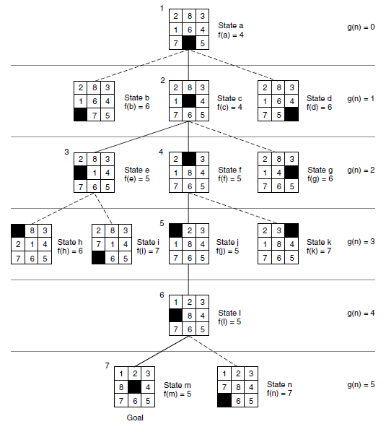
Best First Search (non Greedy) – Sound Familiar?
f(n) = g(n) + h(n)
g(n) = distance from start state
h(n) = no. of tiles out of place
Non Greedy
Notes:
In this case the non-greedy approach evaluates both possibilities (3 and 4) to see which might be better. The best is then found one move later.
The greedy version would just pick one and continue.

Slide 16
Beam Search
Beam Search is an optimisation of the Best-First search
  Only the best k paths are kept!
  The rest are discarded
This ensures that we do not suffer from a combinational explosion of possible paths
We always have a constant number of alternatives
  Memory usage is constant
  Time is related to k
Optimisation:
  Ignore leaf nodes that are not goal nodes
Any problems with Beam Search?
Notes:
Since a goal state could potentially be pruned, beam search sacrifices completeness (the guarantee that an algorithm will terminate with a solution, if one exists). Beam search is not optimal (that is, there is no guarantee that it will find the best solution). It returns the first solution found.

Slide 17
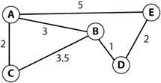
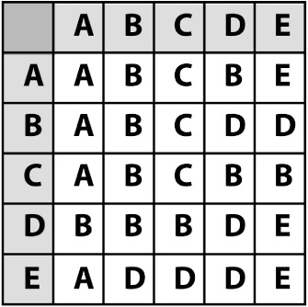
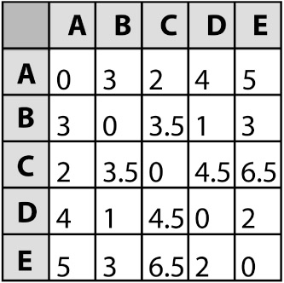
Reducing CPU Overhead
Need to watch out for load spikes
Lots of NPCs all requesting searches
Use pre-calculated paths especially with static maps
  Store with maps, or
  Once at load time (suitable algorithm for this?)
Could also maintain costs
Notes:
Dykstra might be a good algorithm to calculate all paths once off at startup.

Slide 18
NPC getting stuck?
Heuristic:
calculate the distance to NPC’s current waypoint each update step
if this value remains about the same or consistently increases then it’s probably stuck
backup and re-plan

